Slide 1
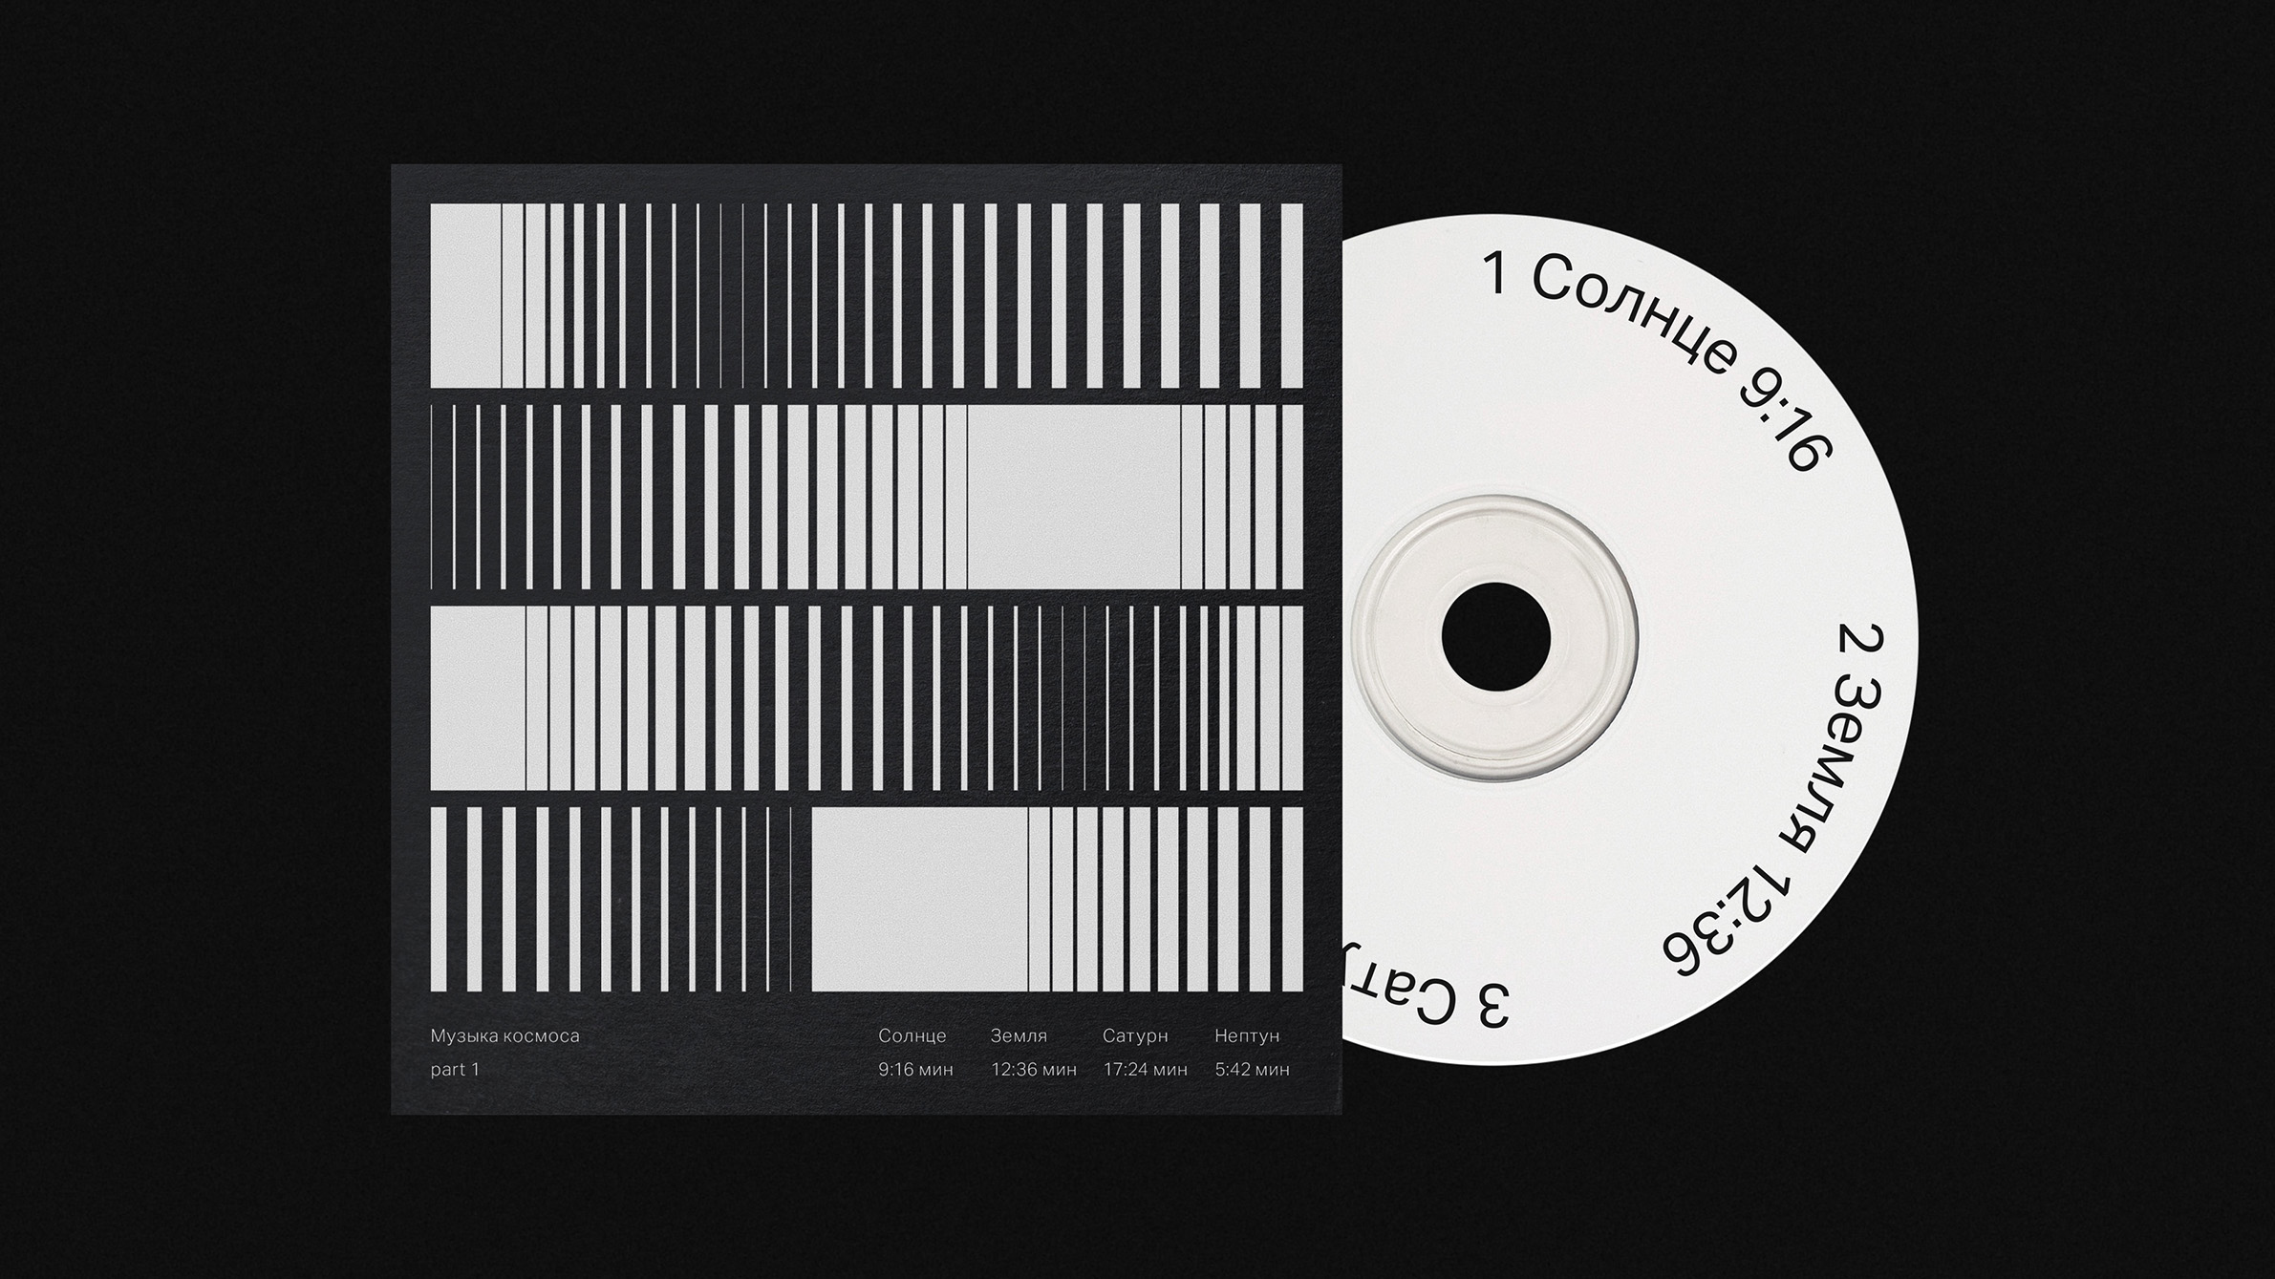
Composing​ ​Music​ ​with​ ​Biaxial​ ​RNNs
Group 5:
Linna Yu
Mingming Liu
Xiuruo Yan
Yanjun Lin
Yu Tong

Slide 2
CONTENTS
1st Problem
3rd Model
2nd Data
4th Results

Slide 3
01
Problem
???

Slide 4



Slide 5



Slide 6


Slide 7
02
Data
Classical music
Pop music
Why interesting

Slide 8
03
Model
Input
Model made
Evidence that support our decision

Slide 9

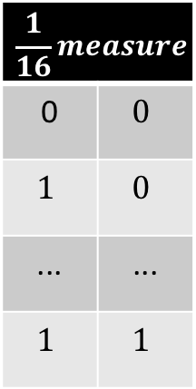
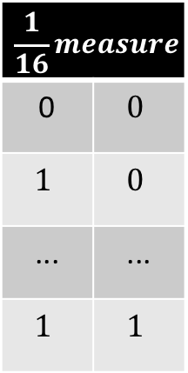
78 x 80
Feature Matrix
Tick
Tick
1
50
4
Position
Previous Vicinity
Beat
$$\frac{1}{16}measure$$
0 | $$0$$
$$1$$ | $$0$$
... | ...
$$1$$ | $$1$$
$$\frac{1}{16}measure$$
0 | $$0$$
$$1$$ | $$0$$
... | ...
$$1$$ | $$1$$
Lowest
Highest
Note
78
12
Pitchclass
12
Previous Context

Slide 10
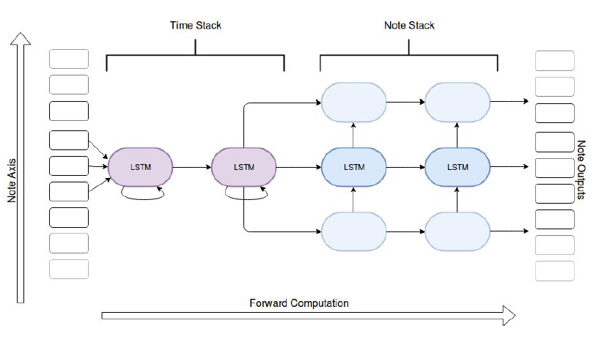

Slide 11
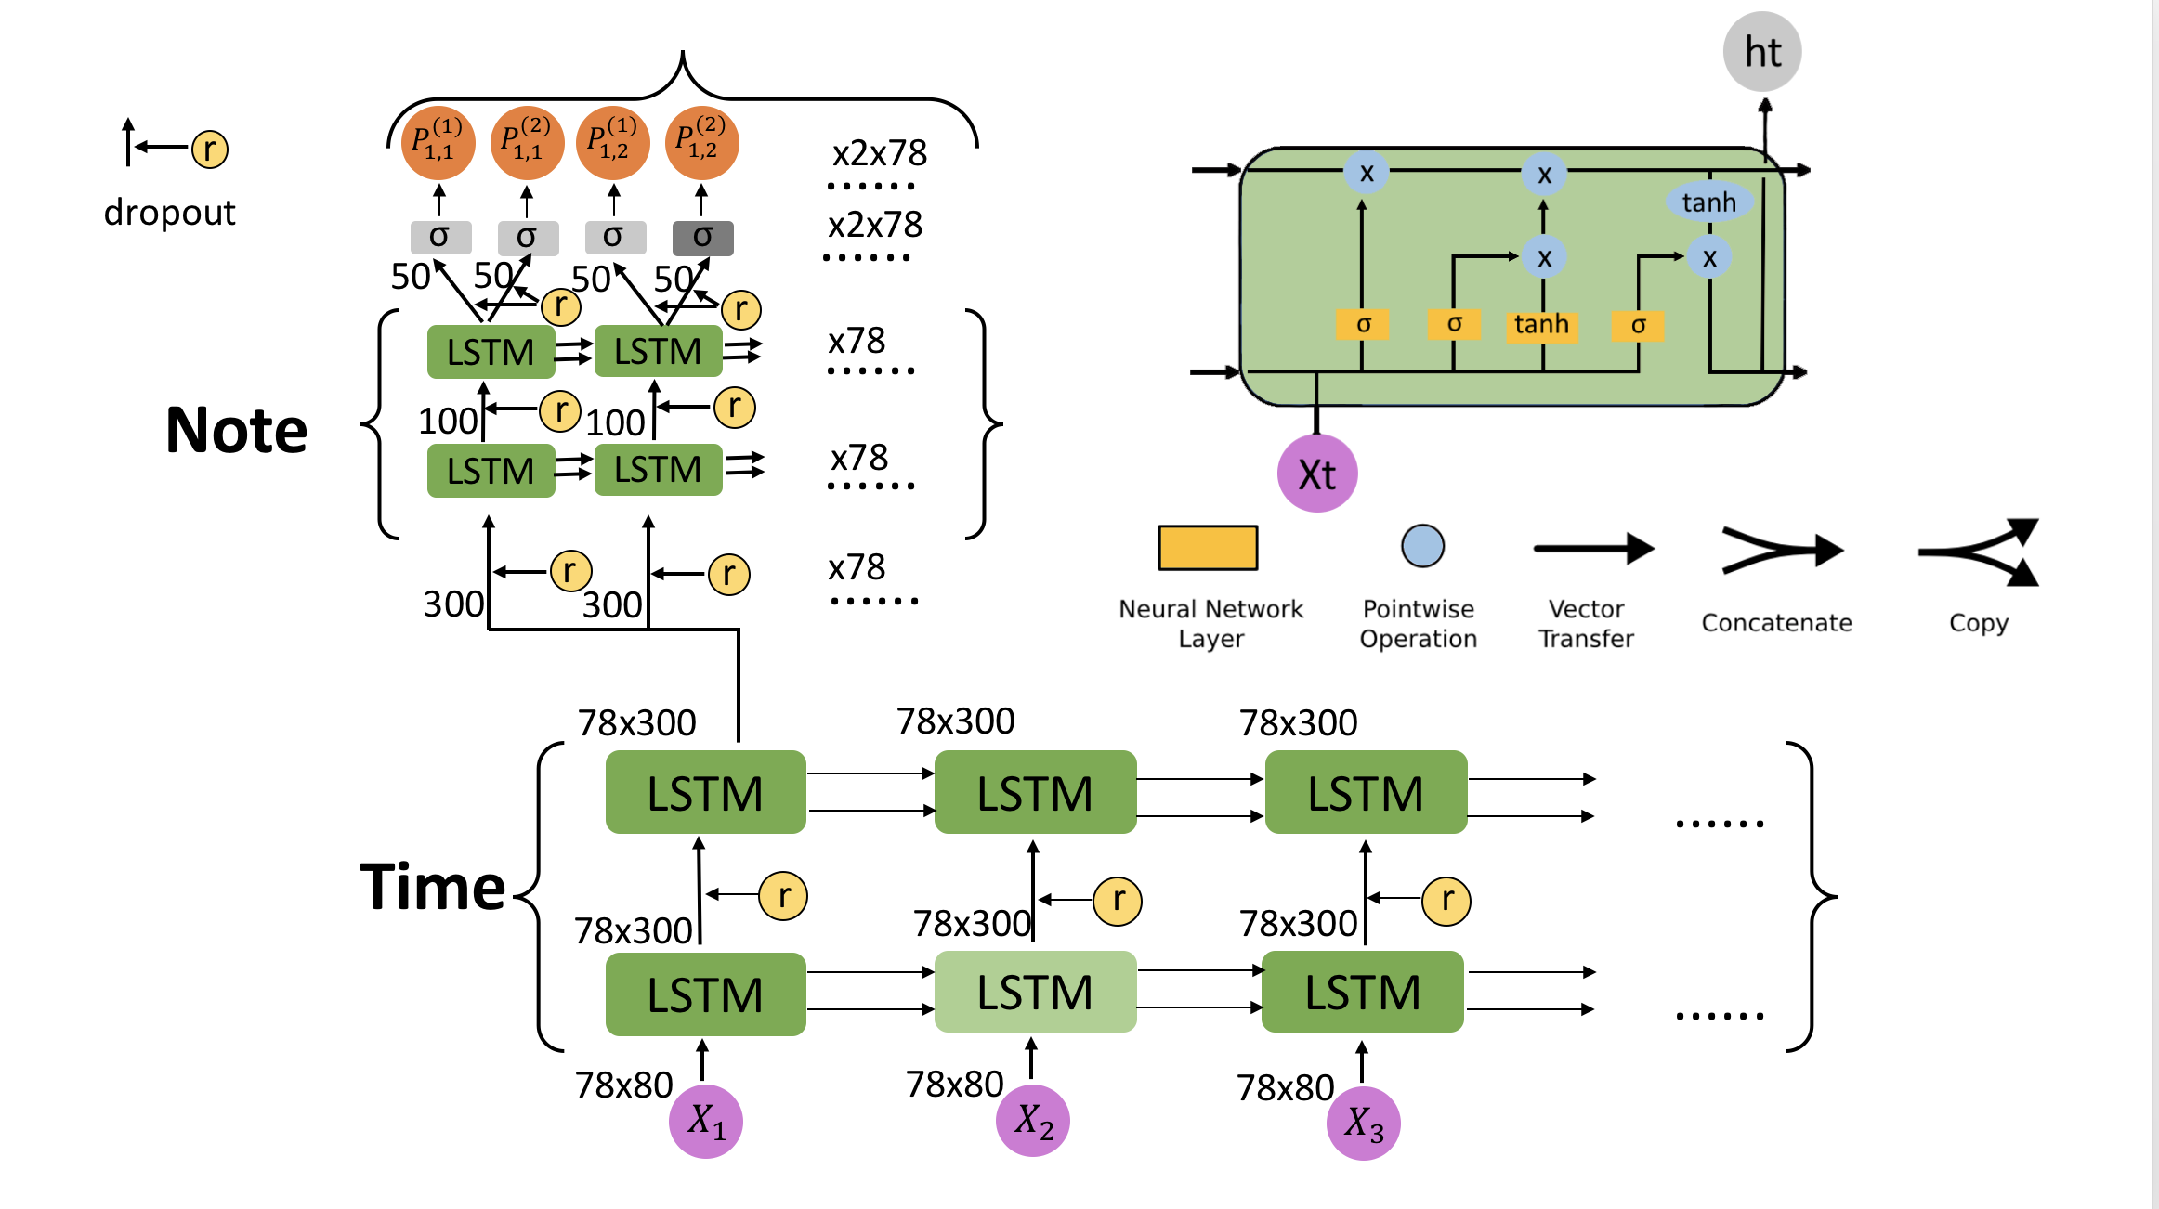

Slide 12
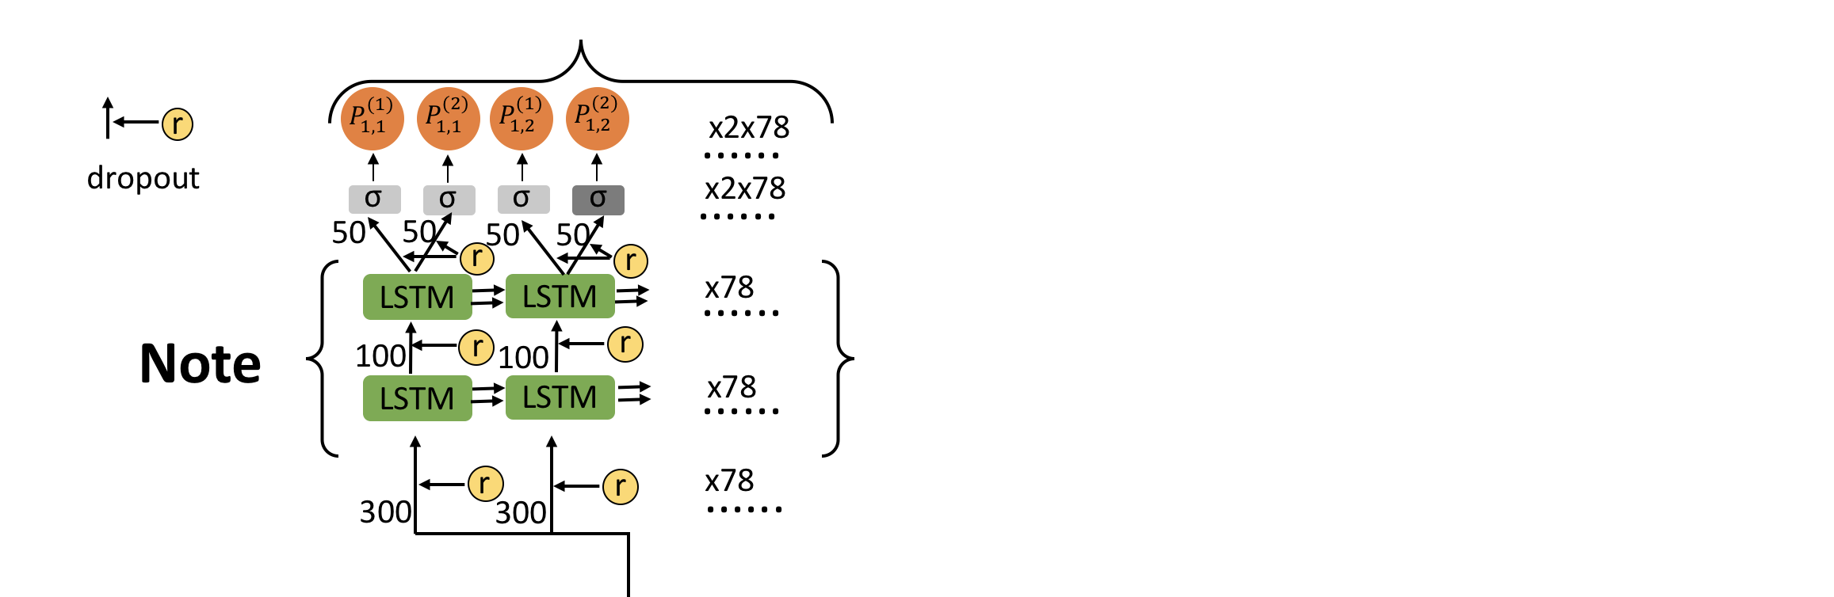
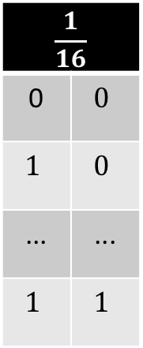
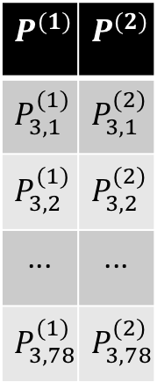
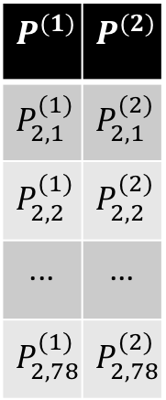
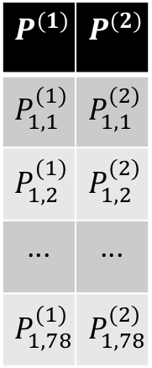
$$\frac{1}{16}$$
0 | $$0$$
$$1$$ | $$0$$
... | ...
$$1$$ | $$1$$
$$P^{(1)}$$ | $$P^{(2)}$$
$$P_{1,1}^{(1)}$$ | $$P_{1,1}^{(2)}$$
$$P_{1,2}^{(1)}$$ | $$P_{1,2}^{(2)}$$
... | ...
$$P_{1,78}^{(1)}$$ | $$P_{1,78}^{(2)}$$
$$P^{(1)}$$ | $$P^{(2)}$$
$$P_{2,1}^{(1)}$$ | $$P_{2,1}^{(2)}$$
$$P_{2,2}^{(1)}$$ | $$P_{2,2}^{(2)}$$
... | ...
$$P_{2,78}^{(1)}$$ | $$P_{2,78}^{(2)}$$
$$P^{(1)}$$ | $$P^{(2)}$$
$$P_{3,1}^{(1)}$$ | $$P_{3,1}^{(2)}$$
$$P_{3,2}^{(1)}$$ | $$P_{3,2}^{(2)}$$
... | ...
$$P_{3,78}^{(1)}$$ | $$P_{3,78}^{(2)}$$
......
78x2
78x2
78x2

Slide 13
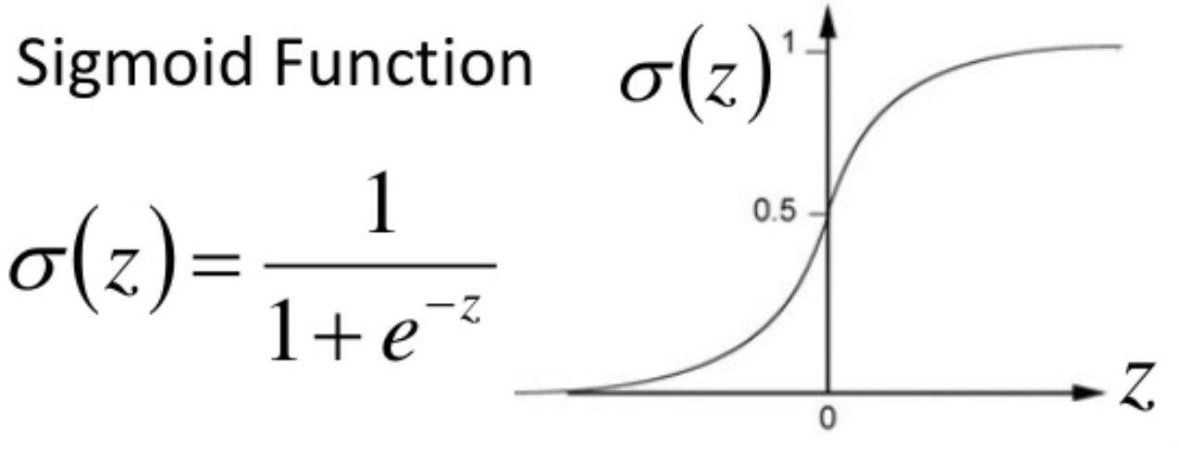
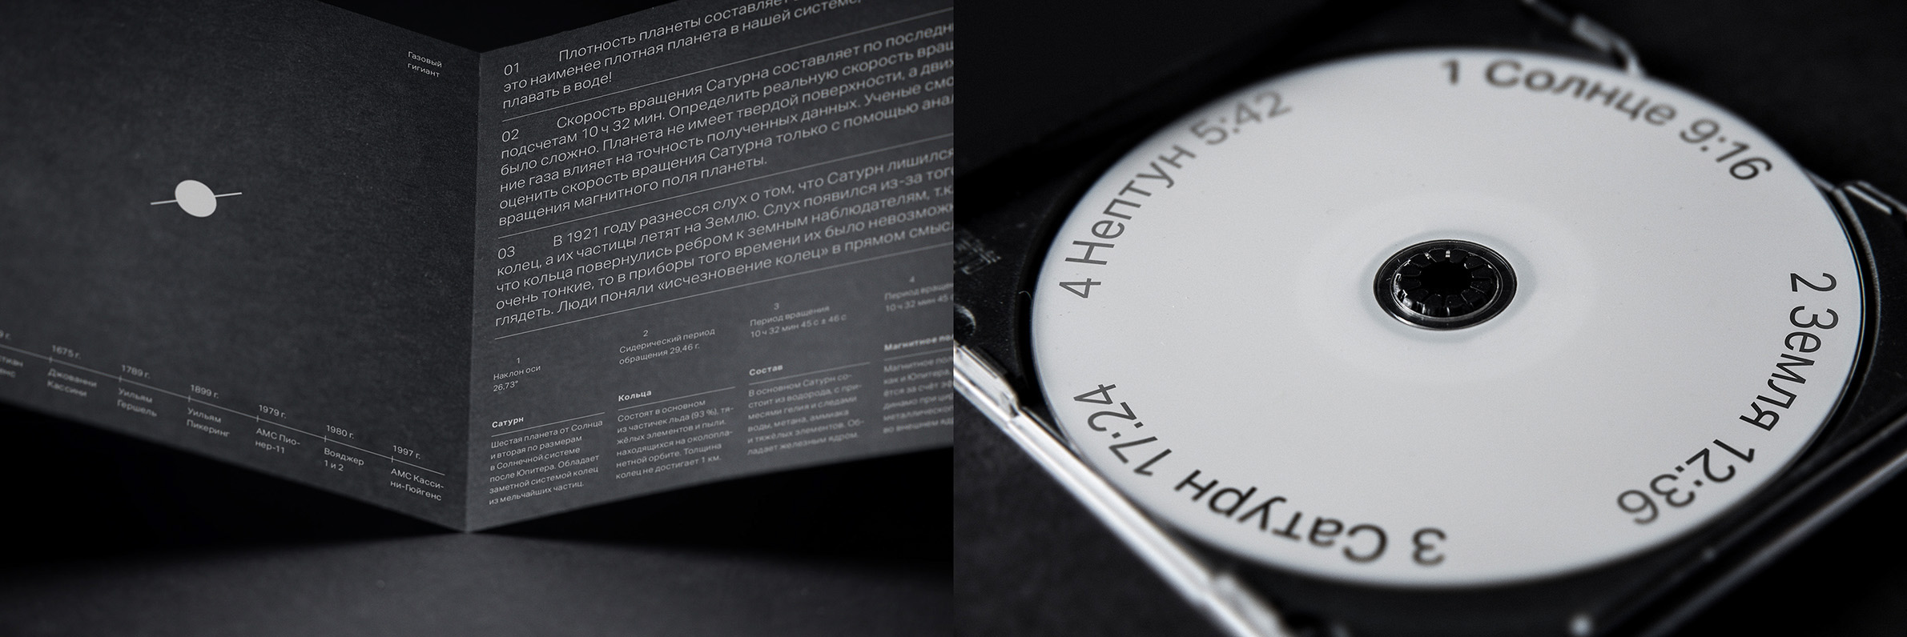
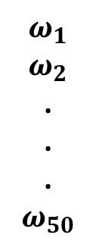
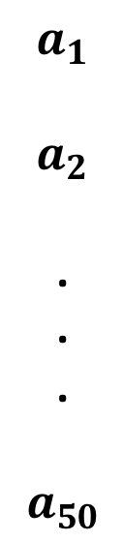
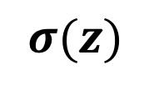
$$a_{1}$$
$$a_{2}$$
.
.
.
$$a_{50}$$
$$ω_{1}$$
$$ω_{2}$$
.
.
.
$$ω_{50}$$
b
z
+
$$σ(z)$$

Slide 14
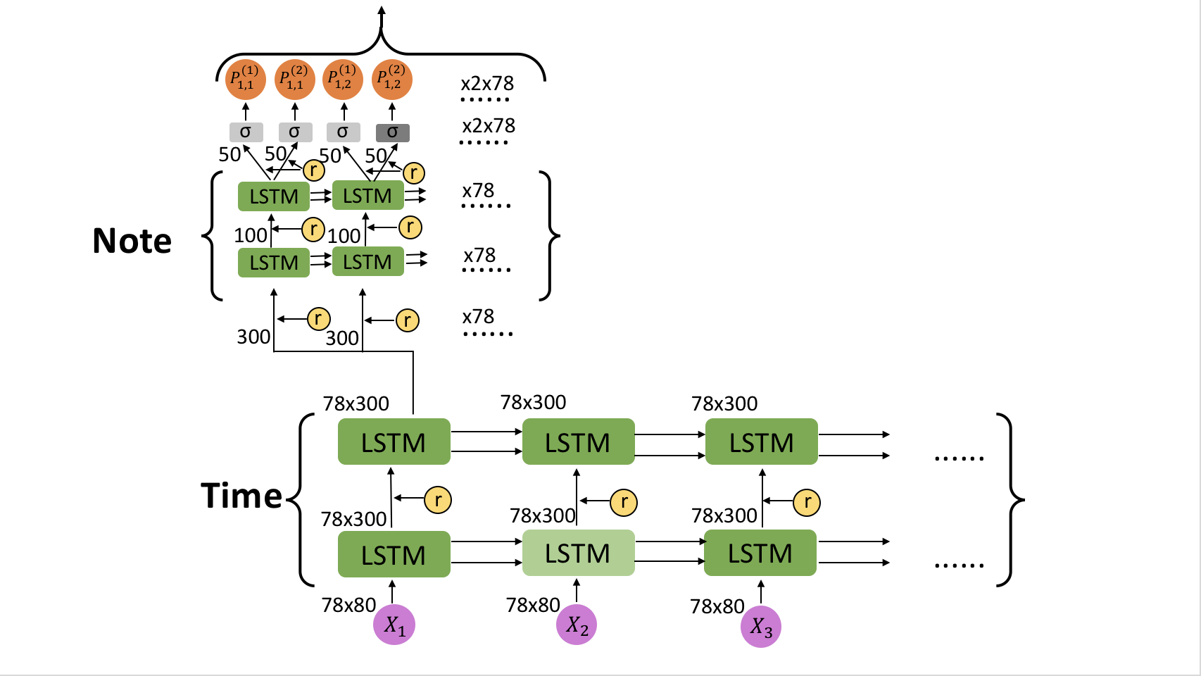
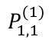
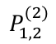
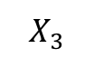
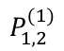
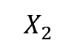
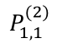
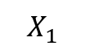
$$P_{1,1}^{(1)}$$
$$P_{1,1}^{(2)}$$
$$P_{1,2}^{(1)}$$
$$P_{1,2}^{(2)}$$
......
x2x78
03
x2x78
σ
σ
σ
σ
......
50
50
50
50
r
r
......
LSTM
LSTM
x78
Note
100
r
100
r
r
......
LSTM
LSTM
x78
dropout
x78
r
r
......
300
300
78x300
78x300
78x300
LSTM
LSTM
LSTM
......
Time
r
r
r
78x300
78x300
78x300
LSTM
LSTM
LSTM
......
78x80
78x80
78x80
$$X_{1}$$
$$X_{2}$$
$$X_{3}$$

Slide 15
04
Results
Pop music results
Classical music results
How we know it works
How others can use it

Slide 16



Slide 17
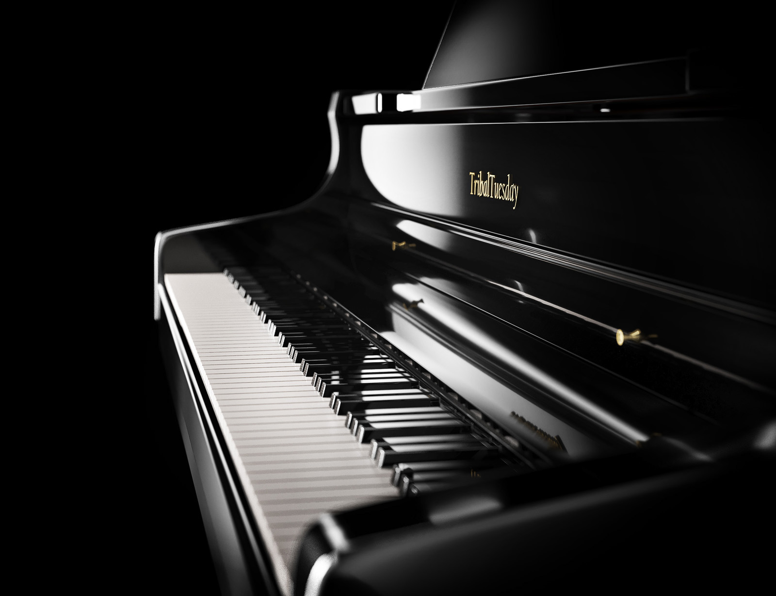

Slide 18

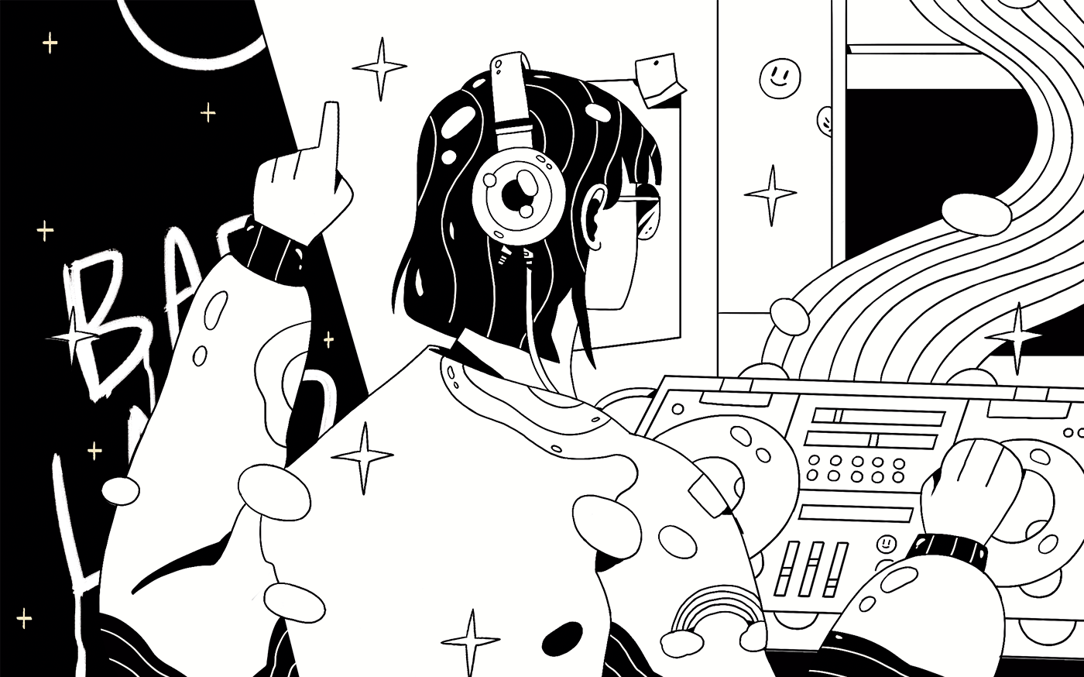

Slide 20
